Slide 1
W2– Operating Systems Architectural Interface, Exception Control flow
Reading Reference: Textbook Chapter 1, 2
CSCE 313 Spring 2017

Slide 2
Content for this week
OS roles and its key challenges (Text: Chap. 1)
Control Flow in a modern computer system (Text: Chap. 2)
Normal flow of commands and data versus anything that happens “out of the ordinary” .. how do we handle that?
Architectural Interface to the OS (Text: Chap. 2)
features we design in HW to facilitate the OS to meet some key challenges
CSCE-313 Spring 2017

Slide 3

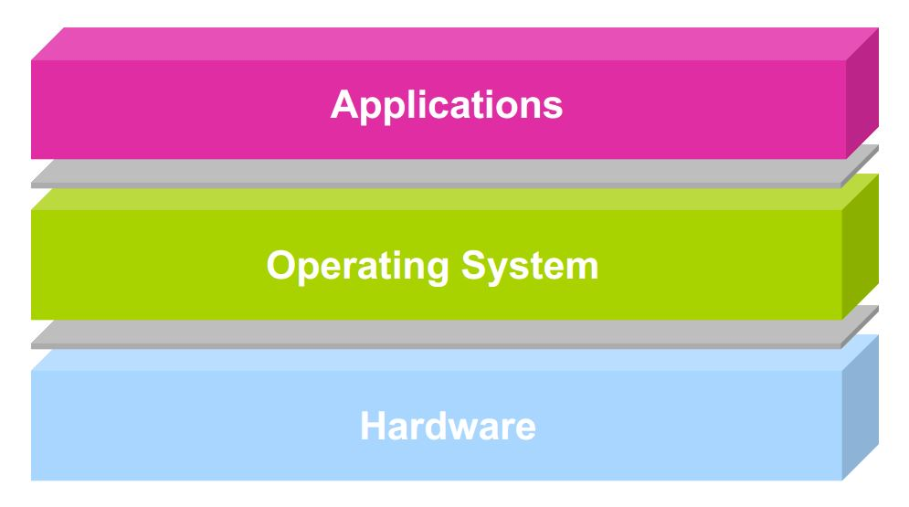

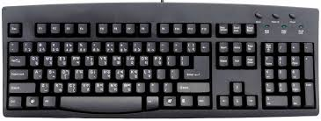
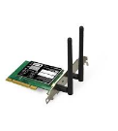


Operating System Roles
user2
user3
user1
user2
user3
user4
user1
user4
Referee
Manage sharing of resources, Protection, Isolation
Resource allocation, isolation, communication
Illusionist
Provide clean, easy to use abstractions of physical resources
Infinite memory, dedicated machine
Masking limitations, virtualization
Glue
Common services
Storage, Window system, Networking
Sharing, Authorization
Look and feel
Application Programs/Processes
return
Processor
Memory
Packet I/O
storage
CSCE-313 Spring 2017

Slide 4
What, then, is an Operating System?
The OS controls and coordinates the use of system resources.
Primary goal: Provide a convenient environment for a user to access the available resources (CPU, memory, I/O)
Provide appropriate abstractions (files, processes, ...)
“virtual machine”
Secondary goal: Efficient operation of the computer system.
Key facets of Resource Management
Transforming: Create virtual substitutes that are easier to use.
Multiplexing: Create the illusion of multiple resources from a single resource
Scheduling: “Who gets the resource when?”
CSCE-313 Spring 2017

Slide 5
What an operating system is not
OS is not a language or a compiler
OS is not a command interpreter / window system
OS is not a library of commands
OS is not a set of utilities
CSCE-313 Spring 2017

Slide 6
Key OS Challenges
Reliability
Does the system do what it was designed to do?
Availability
What portion of the time is the system working?
Mean Time To Failure (MTTF), Mean Time to Repair
CSCE-313 Spring 2017

Slide 7
Key OS Challenges
Servicability
Simplicity and Ease of system repair and maintenance
Security
An OS needs both a security policy (what is permitted) and an enforcement mechanism (only allow permitted actions)
Can the system be compromised by an attacker?
Privacy: Data is accessible only to authorized users
CSCE-313 Spring 2017

Slide 8
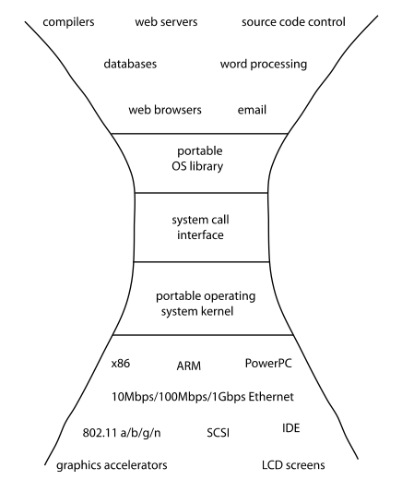
Key OS Challenges
Portability
For programs:
Application programming interface (API)
Abstract machine interface
For the operating system
Hardware abstraction layer
CSCE-313 Spring 2017

Slide 9
Key OS Challenges
Performance
Latency/response time
How long does an operation take to complete?
Throughput
How many operations can be done per unit of time?
Overhead
How much extra work is done by the OS?
Fairness
How equal is the performance received by different users?
Predictability
How consistent is the performance over time?
CSCE-313 Spring 2017

Slide 10
Challenges in Modern OSs
Smart Phones
Responsiveness, security
Embedded Systems
Reliable
Web Servers
Supporting billions of requests/sec efficiently
Virtual Machines
Low overhead and also proper h/w virtualization
Server Clusters
Hide the clustering details from application programs
1/23/2017

Slide 11
Challenges in Tomorrow’s OSs
Existing challenges would be more critical
OSs controlling future self driving cars, or traffic lights need to be absolutely reliable, secure, and efficient
The future of OSs is intertwined with that of emerging computing hardware
Giant-scale data centers
Increasing numbers of processors per computer
Newer portable devices
Very large scale storage
1/23/2017

Slide 12
Content for this week
OS roles and its key challenges (Text: Chap. 1)
Control Flow in a modern computer system (Text: Chap. 2)
Normal flow of commands and data versus anything that happens “out of the ordinary” .. how do we handle that?
Architectural Interface to the OS (Text: Chap. 2)
features we design in HW to facilitate the OS to meet some key challenges
CSCE-313 Spring 2017

Slide 13
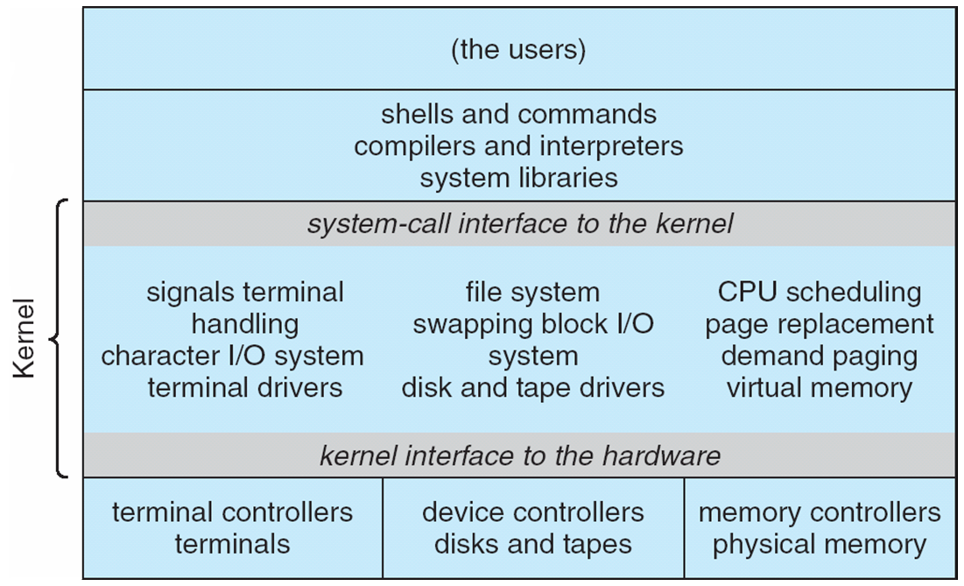
Traditional UNIX System Structure
CSCE-313 Spring 2017

Slide 14
Control Flow
Computers do only one thing
From startup to shutdown, a CPU simply reads and executes (interprets) a sequence of instructions, one at a time
This sequence is the system’s physical control flow (or flow of control)
Physical control flow
<startup>
inst₁
inst₂
inst₃
…
inst_{n}
<shutdown>
Time
CSCE-313 Spring 2017

Slide 15
What alters the Control Flow?
Program-assisted mechanisms for changing control flow:
Jumps and branches—react to changes in program state
Call and return using stack discipline—react to program state
Insufficient for a useful system
Difficult for the CPU to react to other changes in system state
Data arrives from a disk or a network adapter
Instruction divides by zero
User hits control-C at the keyboard
System needs mechanisms for “exception control flow”
CSCE-313 Spring 2017
Notes:
Imagine if you are placing an order at a counter and ask for an item NOT on the Menu. Or if you ask for the Manager. Or if you are checking out groceries and decide to pay in Canadian Dollars ☺. All of these will create some sort of exception requiring the attention of special procedures.

Slide 16
Exception Control Flow
An exception is a transfer of control to the OS in response to some event (i.e., change in processor state)
User Process
OS
event
current
exception
next
exception processing
by exception handler
exception
return (optional)
CSCE-313 Spring 2017

Slide 17
Types of Exceptions
Synchronous (i.e. aligned to an event or time)
Asynchronous (can happen without notice)
CSCE-313 Spring 2017

Slide 18
Asynchronous Exceptions (Interrupts)
Caused by events external to processor
Indicated by setting the processor’s interrupt pin(s)
Handler returns to “next” instruction.
Examples:
I/O interrupts
Key pressed on the keyboard
Arrival of packet from network
Hard-reset interrupt
Hitting reset button
Soft-reset interrupt
Hitting control-alt-delete to initiate restart on a PC
CSCE-313 Spring 2017

Slide 19
Interrupt Vectors
Exception
numbers
Each type of event has a unique exception number k
Index into jump table (a.k.a., interrupt vector)
Jump table entry k points to a function (exception handler).
Handler k is called each time exception k occurs.
code for
exception handler 0
interrupt
vector
code for
exception handler 1
0
1
code for
exception handler 2
2
...
n-1
...
code for
exception handler n-1
CSCE-313 Spring 2017

Slide 20
Synchronous Exceptions (Traps, Faults, Aborts)
Caused by events that occur as result of executing an instruction:
Traps
Intentional
Examples: system calls, breakpoint traps, special instructions
Returns control to “next” instruction
Faults
Unintentional but possibly recoverable
Examples: Page Faults
Either re-executes faulting (“current”) instruction or aborts
CSCE-313 Spring 2017

Slide 21
Synchronous Exceptions (Traps, Faults, Aborts)
Caused by events that occur as result of executing an instruction:
Aborts
Unintentional and unrecoverable
Examples: parity error, machine check
Aborts current program or entire OS
CSCE-313 Spring 2017

Slide 22
Trap Example
Opening a File
User calls open(filename, options)
Function open executes system-call instruction: int $0x80
OS must find or create file, get it ready for reading or writing
Returns integer file descriptor
User Process
OS
int
exception
pop
Open file
return
CSCE-313 Spring 2017

Slide 23
Fault Example #1
int a[1000];
main ()
{
a[500] = 13;
}
Memory Reference
User writes to memory location
That portion (page) of user’s memory is currently on disk
Page handler must load page into physical memory
Returns to faulting instruction
Successful on second try
User Process
OS
event
page fault
Create page and load into memory
return
CSCE-313 Spring 2017

Slide 24
Fault Example #2
Illegal Memory Reference
User writes to memory location
Address is not valid
Page handler detects invalid address
Sends SIGSEGV signal to user process
User process exits with “segmentation fault”
int a[1000];
main ()
{
a[5000] = 13;
}
User Process
OS
event
page fault
Detect invalid address
Signal process
CSCE-313 Spring 2017

Slide 25
Summarizing Control Flow Exceptions
Events that require nonstandard control flow
Are Synchronous (Traps, Faults, Aborts) OR Asynchronous (I/O Interrupts, Hard or Soft Reset etc.)
Generated Externally (interrupts) or Internally (traps and faults)
OS decides how to handle
CSCE-313 Spring 2017

Slide 26
Preview: User/Kernel (Privileged) Mode
User Mode
interrupt
FP exception
syscall
rtn
FP Exception error
rfi
Kernel Mode
exit
exec
Limited HW access
Full HW access
CSCE-313 Spring 2017
Notes:
Processor routinely checks for interrupts and if one is logged, it goes back to save the state of the process it is executing and enters the kernel to service the interrupt. The service is done by entering a interrupt vector table which contains the address of the specific interrupt service routine. Once the routine is serviced the kernel gives control back to the user process.
In multiprocessor systems, only one processor has to service the interrupt from an external device.
What happens when you move a mouse pointer? Each move or point or click registers as an interrupt which is noticed by the processor which moves the control back to the Kernel to service the interrupt routine and that shows up as an action to its associated process (e.g. move of mouse pointer in the active window, or highlight of a word selected, etc.)
An alternative to Interrupt would be “polling” where the Kernel would go in a round-robin fashion to check the status of each device to see if they have an interrupt.

Slide 27
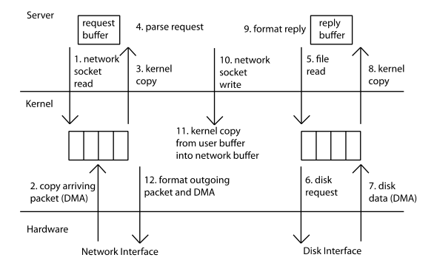
Example: Web Server
syscall
syscall
syscall
RTU
RTU
wait
wait
interrupt
interrupt
CSCE-313 Spring 2017

Slide 28
Content for this week
OS roles and its key challenges (Text: Chap. 1)
Control Flow in a modern computer system (Text: Chap. 2)
Normal flow of commands and data versus anything that happens “out of the ordinary” .. how do we handle that?
Architectural Interface to the OS (Text: Chap. 2)
features we design in HW to facilitate the OS to meet some key challenges
CSCE-313 Spring 2017

Slide 29
Architectural Support for OS
Operating systems mediate between applications and the physical hardware of the computer
Key goals of an OS are to enforce protection and resource sharing
If done well, applications can be oblivious to HW details
CSCE-313 Spring 2017

Slide 30
Challenge: Protection
Why do we execute code with restricted privileges?
Either because the code is buggy or if it might be malicious
Some examples:
A script running in a web browser
A program you just downloaded off the Internet
A program you just wrote that you haven’t tested yet
CSCE-313 Spring 2017

Slide 31
Challenge: Resource Sharing
How do we ensure that resources are fairly (and efficiently) shared amongst (and utilized by) user programs?
Some examples:
Many students running code on a department machine
Amazon.com servicing concurrent users
Playing a movie on a computer while typing a project report and printing a document
CSCE-313 Spring 2017

Slide 32
Architectural Features i.e. features we design in HW to facilitate the OS to meet some key challenges
Privileged instructions
Protection modes (user/kernel)
Memory protection mechanisms
Interrupts and exceptions
System calls
Timer (clock)
I/O control and operation
Synchronization primitives (e.g., atomic instructions)
CSCE-313 Spring 2017

Slide 33
Main Points
Dual-mode operation: user vs. kernel
Kernel-mode: execute with complete privileges
User-mode: execute with fewer privileges
Safe control transfer
How do we switch from one mode to the other?
CSCE-313 Spring 2017

Slide 34
Hardware Support: Dual-Mode Operation
Kernel mode
Execution with the full privileges of the hardware
E.g. Read/write to any memory, access any I/O device, read/write any disk sector, send/receive any packet
User mode
Limited privileges
Only those granted by the operating system kernel
On the x86, mode stored in EFLAGS register
CSCE-313 Spring 2017
Notes:
Obviously, you need the part that has full rights to be really reliable!

Slide 35
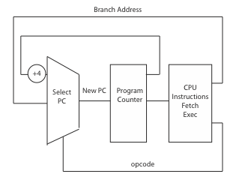
A Model of a CPU
CSCE-313 Spring 2017

Slide 36
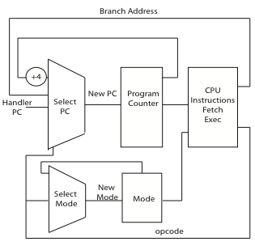
A CPU with Dual-Mode Operation
CSCE-313 Spring 2017

Slide 37
Hardware Support: Dual-Mode Operation
Privileged instructions
Available to kernel
Not available to user code
Limits on memory accesses
To prevent user code from overwriting the kernel or each other
Timer
To regain control from a user program in a loop
CSCE-313 Spring 2017

Slide 38
Privileged Instructions
A select few CPU instructions available only to the OS
Allows access to protected state
Perform global operations
CSCE-313 Spring 2017

Slide 39
Privileged Instructions - Examples
Only the OS should be able to
Directly access I/O devices (disks, printers..)
Allows OS to enforce security and fairness
Manipulate memory management state
E.g., page tables, protection bits, TLB entries, etc.
Adjust protected control registers
User ← → Kernel modes or Raise/Lower interrupt level
Execute the halt instruction
CSCE-313 Spring 2017

Slide 40
Question
What should happen if a user program attempts to execute a privileged instruction?
CSCE-313 Spring 2017

Slide 41
Memory Protection
Memory management hardware provides protection. Examples:
Base and limit registers
Page table pointers, Page Protection, Translation Lookaside Buffer (TLB)
Manipulating memory management hardware uses protected (privileged) instructions
CSCE-313 Spring 2017

Slide 42
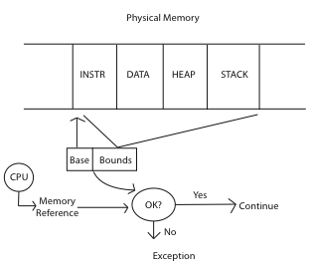
Memory Protection - Example
CSCE-313 Spring 2017

Slide 43
Hardware Timer
Operating system timer is a critical building block
Many resources are time-shared; e.g., CPU
Allows OS to prevent infinite loops
Fallback mechanism by which OS regains control
When timer expires, generates an interrupt
Handled by kernel, which controls resumption context
Basis for OS scheduler; more later…
Setting (and clearing) a timer is a privileged instruction
CSCE-313 Spring 2017

Slide 44
Question
For a “Hello world” program, the kernel must copy the string from the user program memory into the screen memory. Why must the screen’s buffer memory be protected?
CSCE-313 Spring 2017

Slide 45
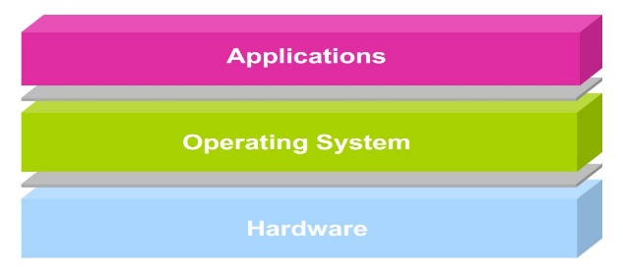
User → Kernel Mode Switch
From user-mode to kernel-mode
Interrupts
Triggered by timer and I/O devices
(Synchronous) Exceptions
Triggered by unexpected program behavior
Or malicious behavior!
System calls (traps) (aka protected procedure call)
Request by program for kernel to do some operation on its behalf
Only limited # of very carefully coded entry points
CSCE-313 Spring 2017

Slide 46
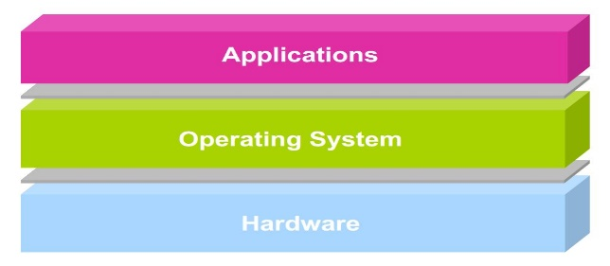
Kernel → User Mode Switch
From kernel-mode to user-mode
New process/new thread start
Jump to first instruction in program/thread
Return from interrupt, exception, system call
Resume suspended execution
Process/thread context switch
Resume some other process
User-level upcall
Asynchronous notification to user program by the kernel
CSCE-313 Spring 2017

Slide 47
Transfer from User to Kernel Mode – Handling Interrupts
On interrupt (x86)
Save current stack pointer
Save current program counter
Save current processor status word (condition codes)
Switch to kernel stack; put SP, PC, PSW on stack
Switch to kernel mode
Vector through interrupt table
Access the interrupt handler
CSCE-313 Spring 2017

Slide 48
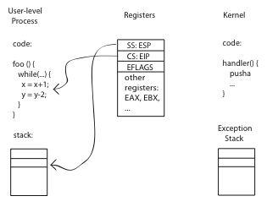
Before
CSCE-313 Spring 2017

Slide 49
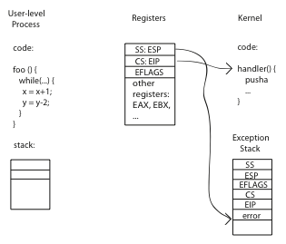
During
CSCE-313 Spring 2017

Slide 50
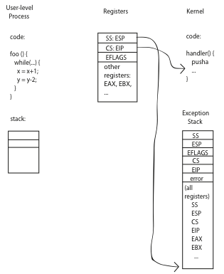
After
CSCE-313 Spring 2017

Slide 51
At the end of handler
Handler restores saved registers
Atomically return to interrupted process/thread
Restore program counter
Restore program stack
Restore processor status word/condition codes
Switch to user mode
CSCE-313 Spring 2017

Slide 52
Kernel System Call Handler
Locate arguments
In registers or on user stack
Copy arguments
From user memory into kernel memory
Protect kernel from malicious code evading checks
Validate arguments
Protect kernel from errors in user code
Copy results back
into user memory
CSCE-313 Spring 2017

Slide 53
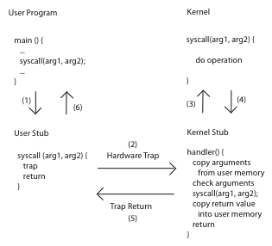
System Calls
CSCE-313 Spring 2017

Slide 54
Summary: User/Kernel (Privileged) Mode
User Mode
interrupt
FP exception
syscall
rtn
FP Exception error
rfi
Kernel Mode
exit
exec
Limited HW access
Full HW access
CSCE-313 Spring 2017
Notes:
Processor routinely checks for interrupts and if one is logged, it goes back to save the state of the process it is executing and enters the kernel to service the interrupt. The service is done by entering a interrupt vector table which contains the address of the specific interrupt service routine. Once the routine is serviced the kernel gives control back to the user process.
In multiprocessor systems, only one processor has to service the interrupt from an external device.
What happens when you move a mouse pointer? Each move or point or click registers as an interrupt which is noticed by the processor which moves the control back to the Kernel to service the interrupt routine and that shows up as an action to its associated process (e.g. move of mouse pointer in the active window, or highlight of a word selected, etc.)
An alternative to Interrupt would be “polling” where the Kernel would go in a round-robin fashion to check the status of each device to see if they have an interrupt.

Slide 55
Example: Web Server (Revisited)
syscall
syscall
syscall
RTU
RTU
wait
wait
interrupt
interrupt
CSCE-313 Spring 2017

Slide 56
Summary of Learnings
OS roles and its key challenges (Text: Chap. 1)
Control Flow in a modern computer system (Text: Chap. 2)
Normal flow of commands and data versus anything that happens “out of the ordinary” .. how do we handle that?
Architectural Interface to the OS (Text: Chap. 2)
features we design in HW to facilitate the OS to meet some key challenges
CSCE-313 Spring 2017

Slide 57
A Real-Life Analogy (Approximate)
A Typical Coffee Shop | Computer System
Store | System
Customer | Process or Program or User Application
Barista/Cashier | Operating System Kernel, Privileged Code
Coffee Machine | CPU
Customer Order | System Call
Order item not on Menu | Exception
Telephone Call | Interrupt
Fire Alarm | Signal
>1 Customers being served | Process Scheduling
Customer realizing at the counter that he needs to go to ATM to get money | Process Context Switching
CSCE-313 Spring 2017

Slide 58

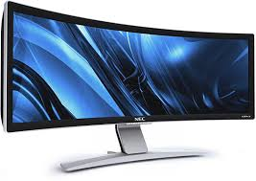
Next Week
Process and Programming Interface
user2
user3
user1
user2
user3
user4
user1
user4
Application Programs/Processes
System calls,
Exceptions
return
System calls,
Exceptions
Privileged
Operations
Processor
Memory
INT
Character O/P
Bock I/O
storage
CSCE-313 Spring 2017

